Slide 1
Soil Structure and Compaction
Emily Courtney and Mia Lorence

Slide 2
What is Soil Structure?
Beneficial bacteria produce a glue-like substance that combines bacteria, organic matter, and soil particles (sand, silt, and clay) to create soil aggregates.
The arrangement of those soil aggregates into different forms creates a soil's structure.

Slide 3

Why Should You Care About the Structure of Your Soil?

Slide 4
What Does Good Soil Structure Do?
Good soil structure creates spaces for air and water in the soil while allowing roots to grow easily.
To increase the quality of your soil you first need to have good soil structure. And to improve your soil structure you need to increase your organic matter and microbial community.
Having good soil structures or stable aggregation, opens the soil for water and air movement which are essential for root health and the health of the microbiology in the soil.
Good Soil Structure increase your soil's water holding capcity and water permeability.
Sources: Utah State University “It’s All About Soil Structure” (2018), UCANR “Building Healthy Soil” (2025)

Slide 5
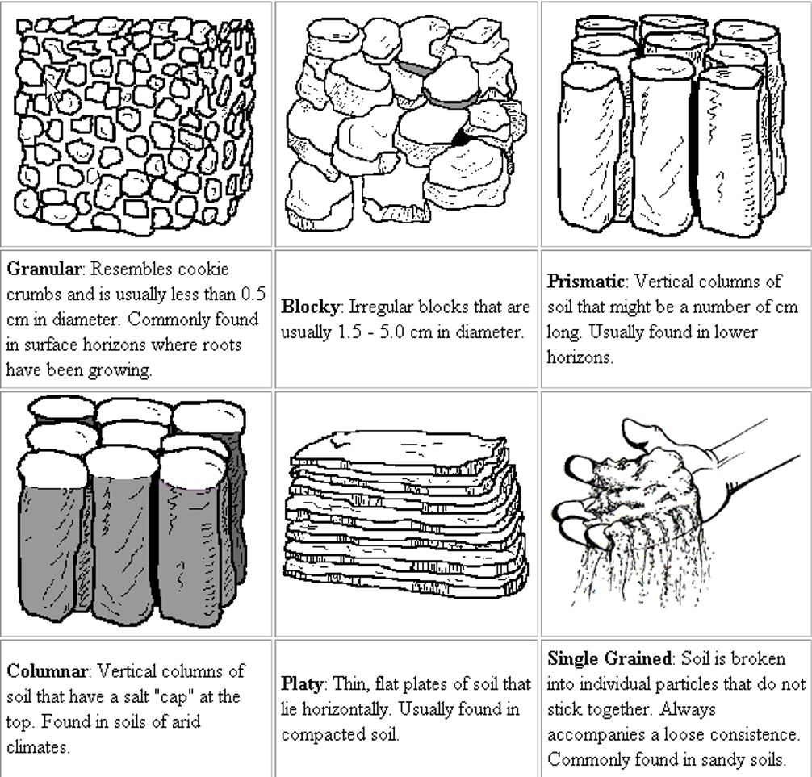
What Makes up a Soil's Structure?
Soil Texture: the size and portion of soil particles within a sample
Organic matter
Sand
Silt
Clay
Soil Structure Types:
Granular
Blocky
Prismatic
Columnar
Platy (Compacted)
Single Grained

Slide 6
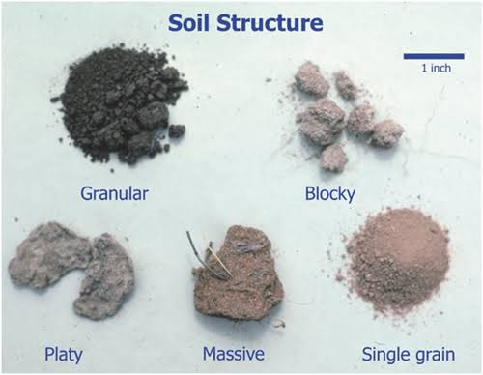
Massive – This structure type has low permeability because it is practically one giant aggregate with no pore space.
Granular – This soul structure has a high permeability with the most pore space
Blocky – This soil structure has medium permeability.
Prismatic or Columnar– This soil structure has a medium permeability, letting water easily slip between the vertical columns.
Platey – This soil structure has low permeability. Platey structures are compacted with plates or sheets of piled horizontally on top of each other.
Single grained – This structure type has high permeability but hardly any water retention. There are no aggregates holding the soil together.

Slide 7
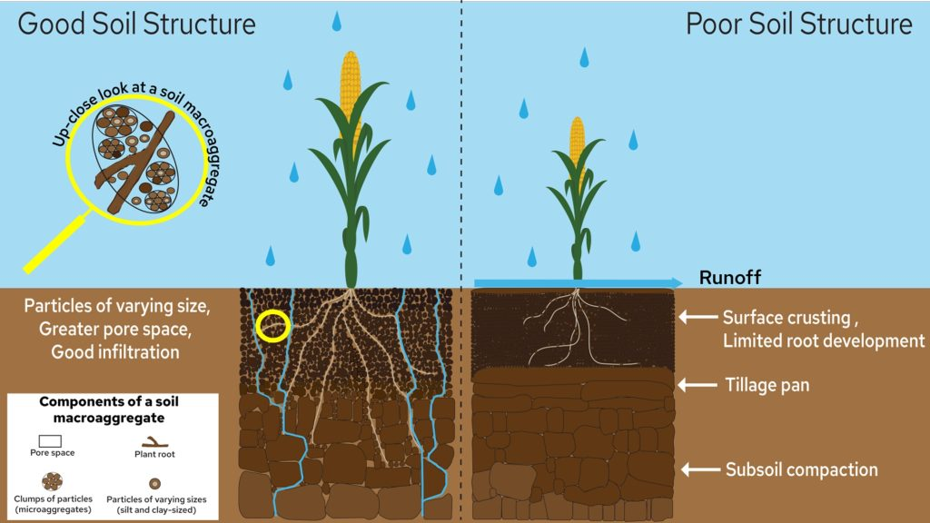
Graphic adapted from Oregon State University Extension and Jastrow and Miller 1998³.

Slide 8
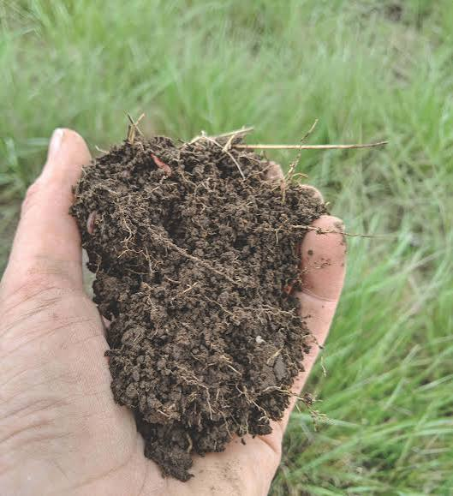
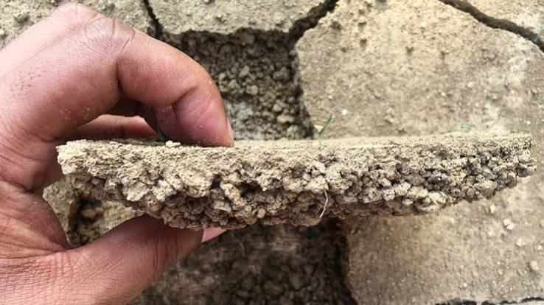
Good Soil Structure
Poor Soil Structure

Slide 9
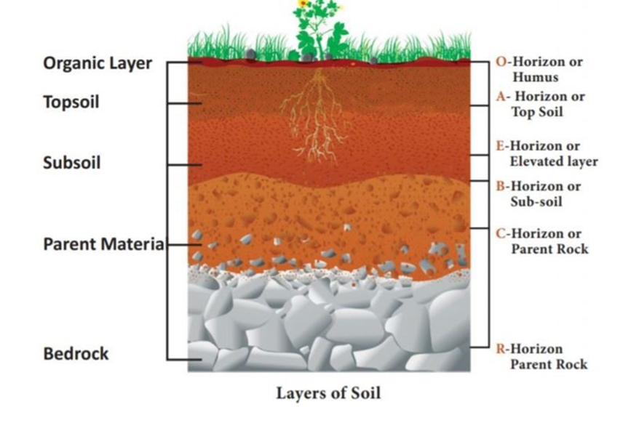
Soil Layers
The average soil depth in Fallbrook and surrounding areas is 40-60 inches deep over weathered bedrock.
Bonsall: 50-90 inches

Slide 10
Soil Structure vs. Soil Texture
A Soils' Texture refers to the proportions or percentages of sand, silt, and clay. These proportions are what determines a soil's class or type. (i.e. sandy loam, loamy clay, etc.)
Vs.
A Soils' Structure refers to the formation of the soil particles (sand, silt, and clay) and organic matter combined together.

Slide 11
Types of Soil in Fallbrook and Temecula Area
Temecula: Greenfield Sandy Loam
Medium fertility
Moderate-rapid permeability
Available water holding capacity is between 5.5 - 7.5 inches
Rooting depth is more than 60 inches
Vista Course Sandy Loam
Medium fertility
Moderate-rapid permeability
Available water holding capacity of 4 – 6 inches
Rooting depth is 27 to 47 inches
Fallbrook Sandy Loam
Medium fertility
Moderate permeability
Available water holding capacity is 4.5 - 8inches
Rooting depth of 28 to 60 inches.

Slide 12
Improving a Soil’s Structure Through Biology
What creates and supports a soil’s structure is the microbiology and organic matter within the soil.
Ways to increase your soil’s biology:
Compost
Compost and/or worm Teas
Worm castings
Beneficial nematodes

Slide 13
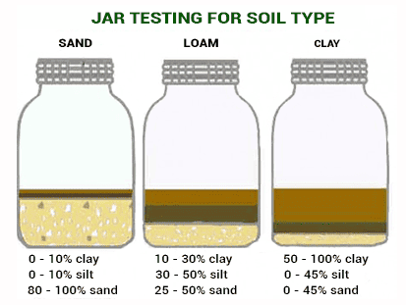
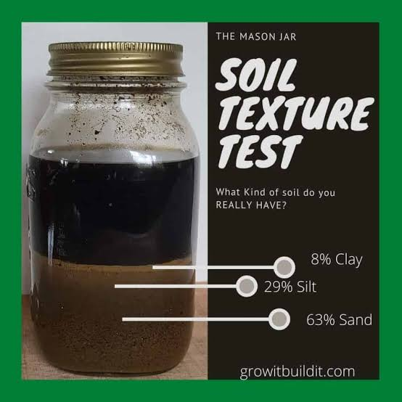
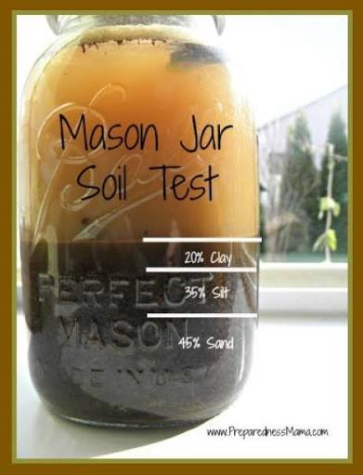
Easy Soil Tests
Jar Test – SOIL TEXTURE
What you'll need: Mason Jar, soil, water, 1tsp of dish soap or water softener
What to do: Fill 1/3 of the jar with soil, add 1sp of dish soap, and fill the rest with water till almost full. Shake the jar for 1 min straight. Let the soil settle for 24hours.

Slide 14
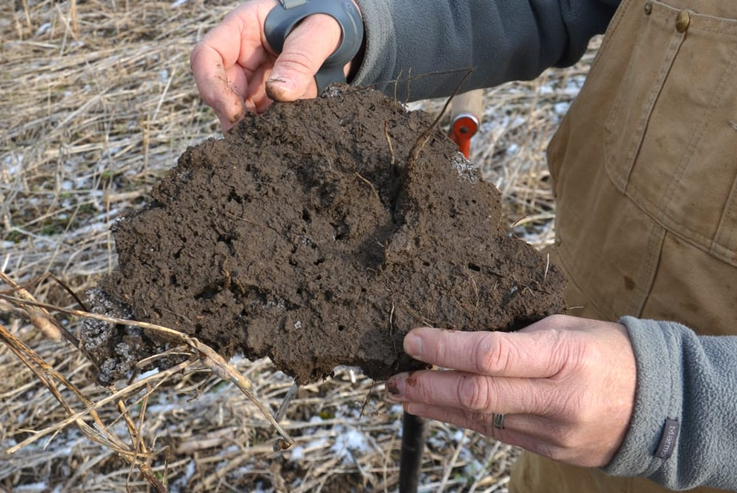
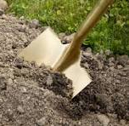
Shovel Test – SOIL STRUCTURE
Perform the test when the soil is moist ​
Dig a 8-12in depth cube of soil and place on a flat surface or tray​
What to look for: break the soil sample in your hands and look for roots, soil clumps, earthworms. If the soil has a plate-like structure running horizontally, it is likely compacted soil.​

Slide 15
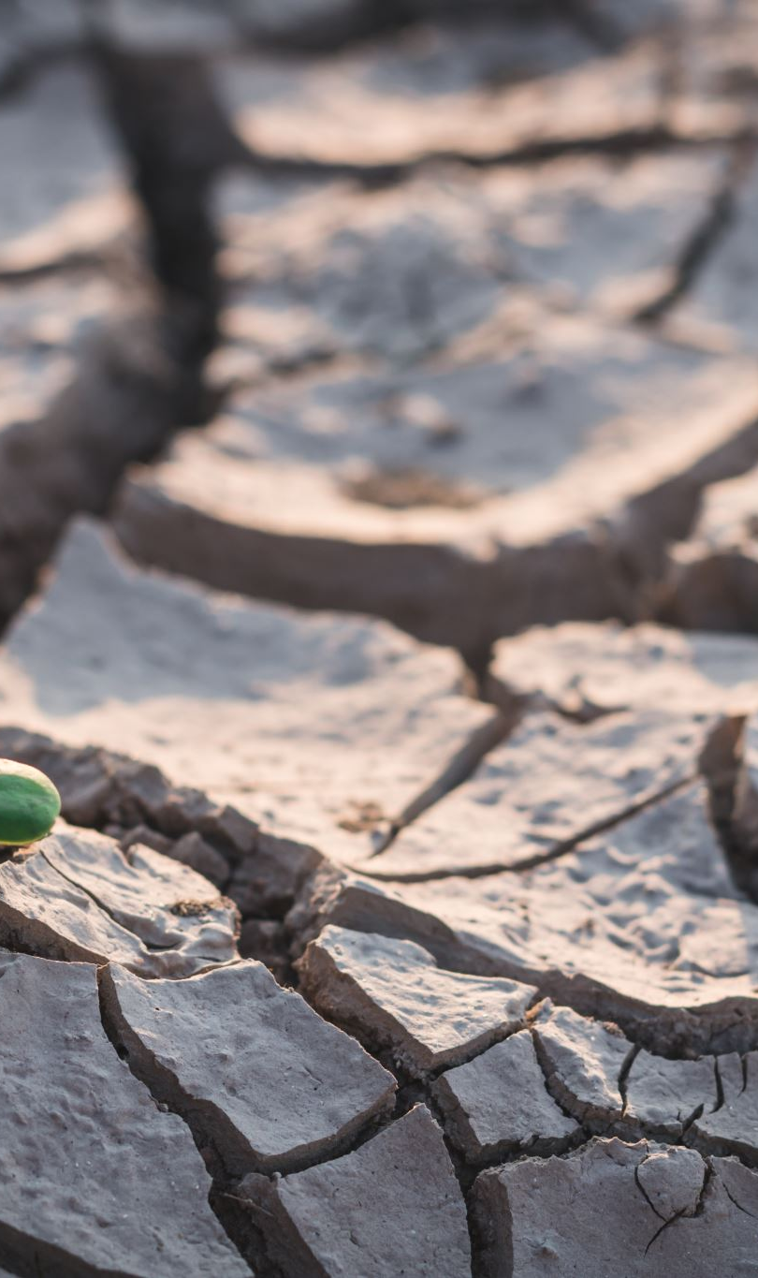
Damages to Soil Structure
There are several ways Soil Structures can become damaged.
Working soil when it is too wet
Excessive tillage
Bare soil and erosion
Heavy axel loads and repeated traffic
Loss of organic matter

Slide 16
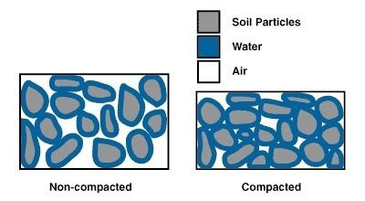
Soil Compaction
Why Pore Space Matters
Pores = pathways for air + water + roots
Compaction → fewer & smaller pores
Soil compaction occurs when soil particles are pressed closer together, reducing pore space.
Less air for roots
Slower water movement
Restricted root growth

Slide 17
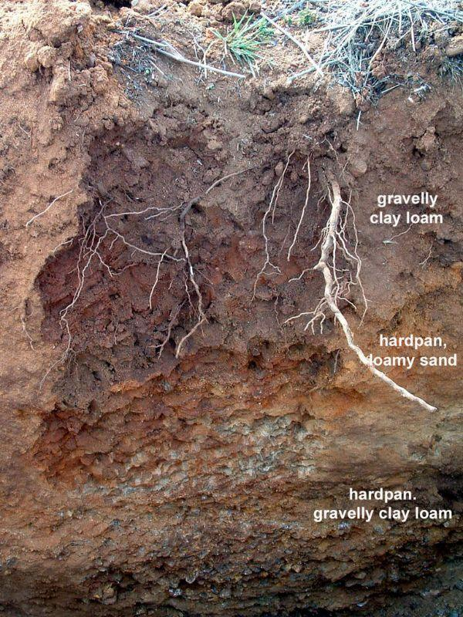
What Crops Are Most Sensitive to Compaction?
No single crop is most sensitive.
Impacts depend on soil, moisture, roots, and traffic.
Examples:
Tomatoes — restricted roots & growth
Alfalfa — highly sensitive to repeated traffic
Tree & vine crops — deep compaction can restrict rooting
Restricted roots = reduced access to water & nutrients

Slide 18
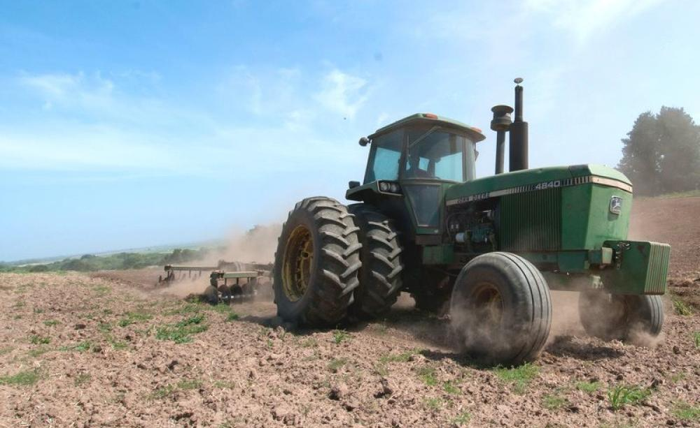
Causes
Wet Soil = Higher Risk
Less resistance to pressure
→ Deeper, longer-lasting compaction
Heavy equipment and repeated wheel traffic
Working or driving on wet soil
Repeated tillage at the same depth
Foot traffic and livestock pressure
Construction, grading, or other heavy loads
Two Forms
Surface: crusting & sealing
Subsoil: hardpans & deep compaction

Slide 19
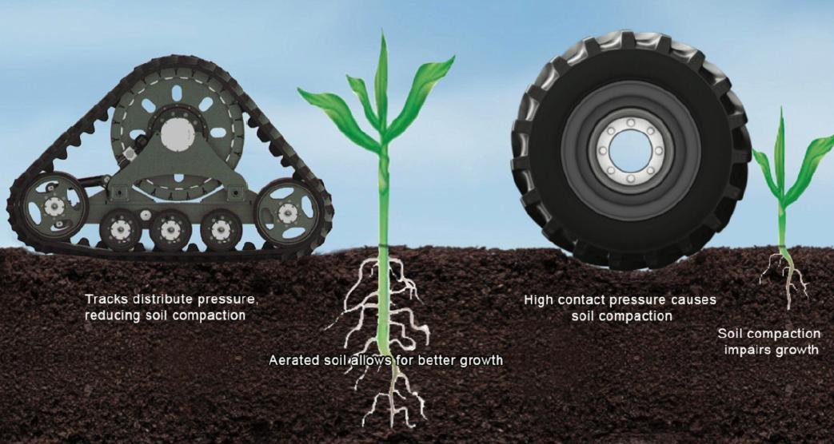
How Much Does a Tractor’s Total Weight Matter?
What Matters Most?
Total weight matters — but axle load is more useful for assessing compaction risk at depth.
Tire size & pressure determine how that load is distributed at the surface.
Wet soil is more vulnerable to compaction, especially under heavier loads.
Think About the Whole System
Tractor + implement weight
Load per axle/tire
Tire size & inflation pressure
Number of passes & traffic pattern
Soil moisture & texture

Slide 20
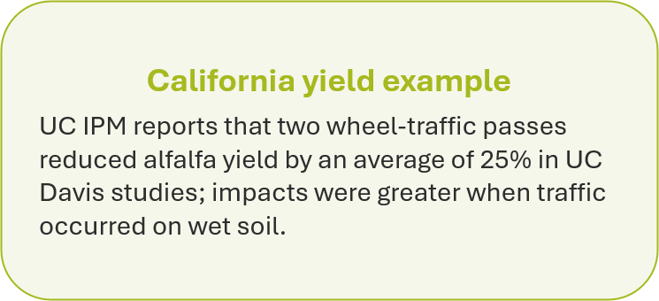
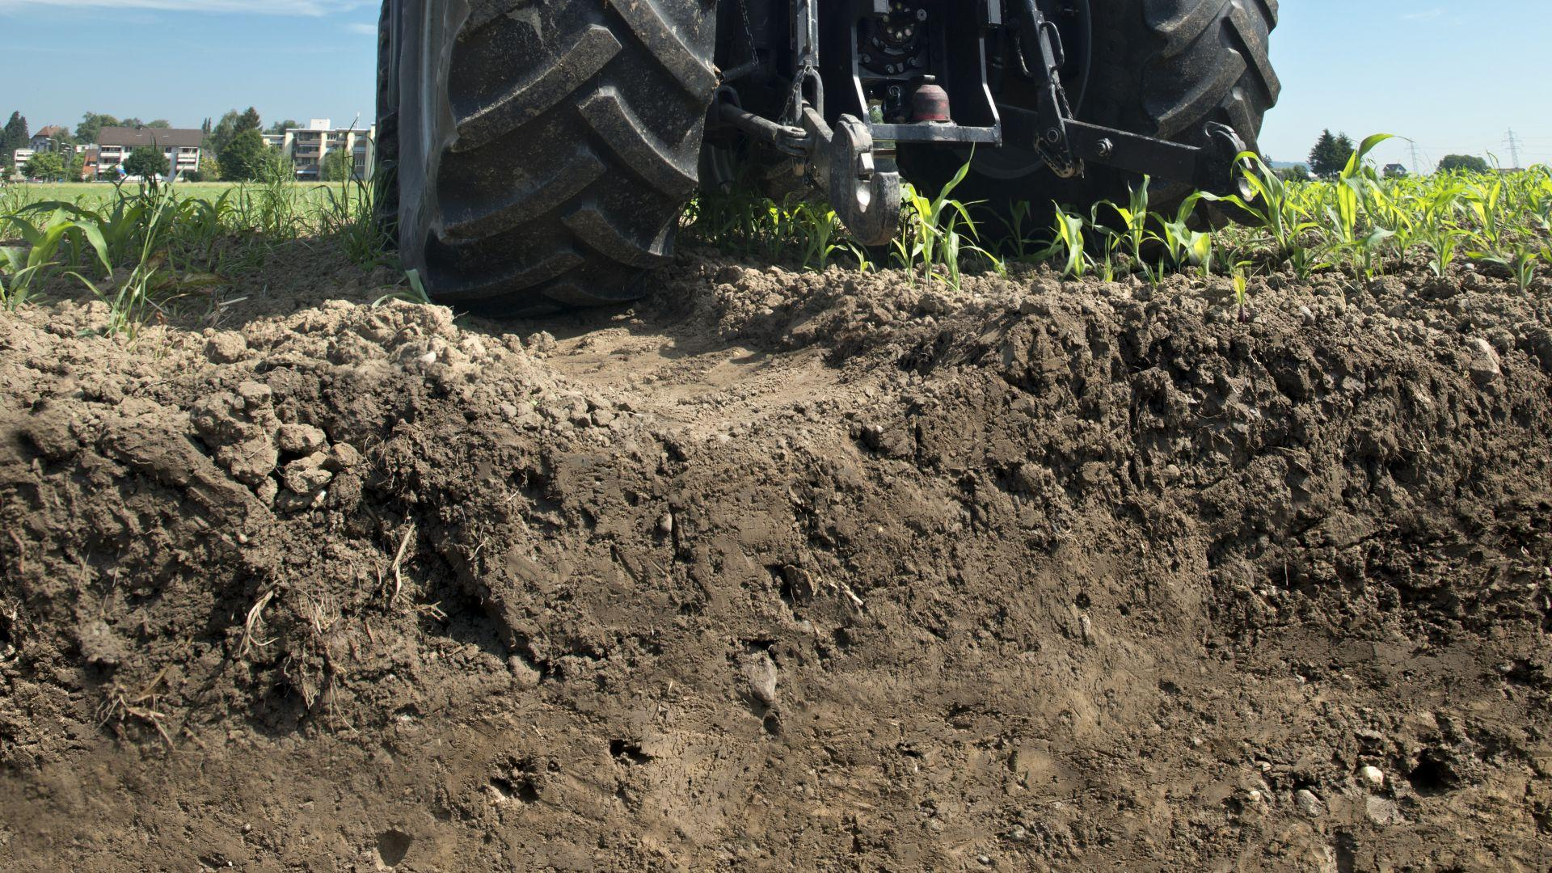

Slide 21
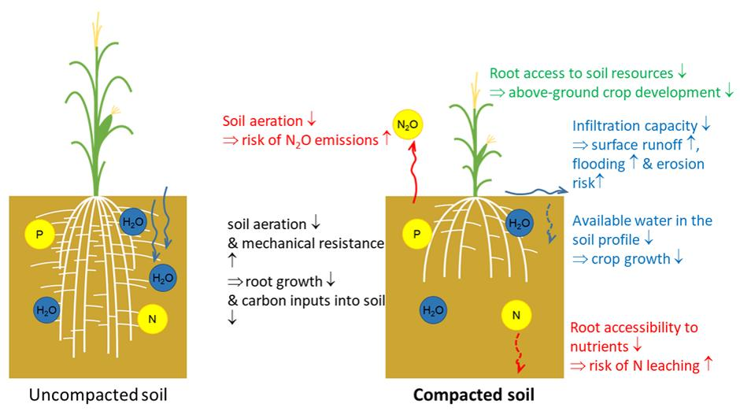
Why Are Compacted Layers a Problem?
Restrict root growth
Limit water movement
Reduce soil oxygen
Can cause poor drainage & runoff
Difficult to correct at depth

Slide 22
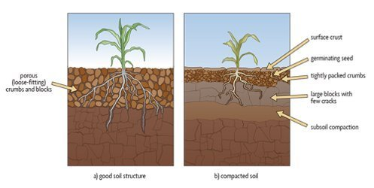
Issues
Restricted root growth
Less water infiltration
Poor drainage & aeration
Reduced nutrient uptake
Lower growth & yields
Compaction → Less pore space → Less access to air & water

Slide 23
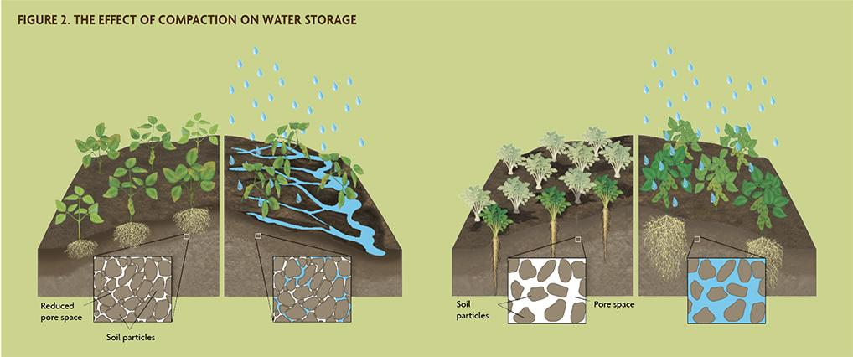
How Does Compaction Affect Infiltration?
Healthy soil
Connected pores allow water to move into the soil
Larger pores improve water movement
Compacted soil
Less pore space → slower infiltration
Water can perch above a compacted layer
More ponding, runoff & erosion
Irrigation becomes less efficient
Compaction → Less pore space → Less water movement

Slide 24
Economic Impact
Lower yields or uneven crop growth
Less efficient use of irrigation water
More runoff/erosion and potential loss of inputs
Extra labor, fuel, and equipment passes to correct the problem
Mechanical remediation can be costly and may not restore soil structure long-term

Slide 25

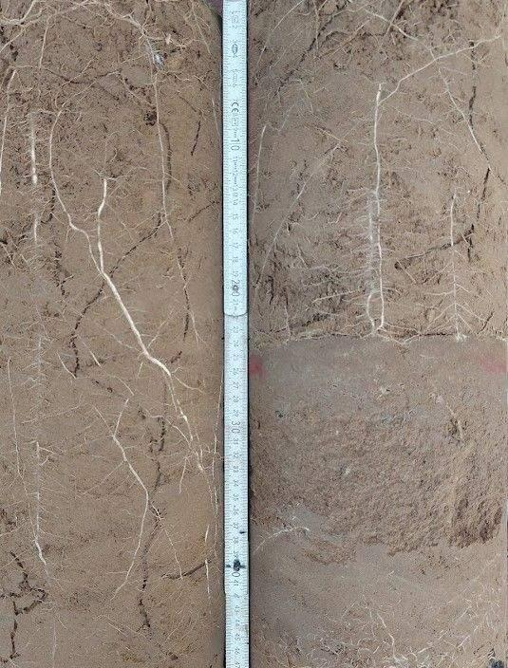
Look for signs
Ponding or slow infiltration
Wheel ruts
Uneven crop growth
Shallow or restricted roots
Dig & compare
Use a shovel to compare compacted and undisturbed areas.
Look for:
Dense layers • Poor structure • Restricted roots
Confirm
Use a soil probe or penetrometer to test resistance.

Slide 26
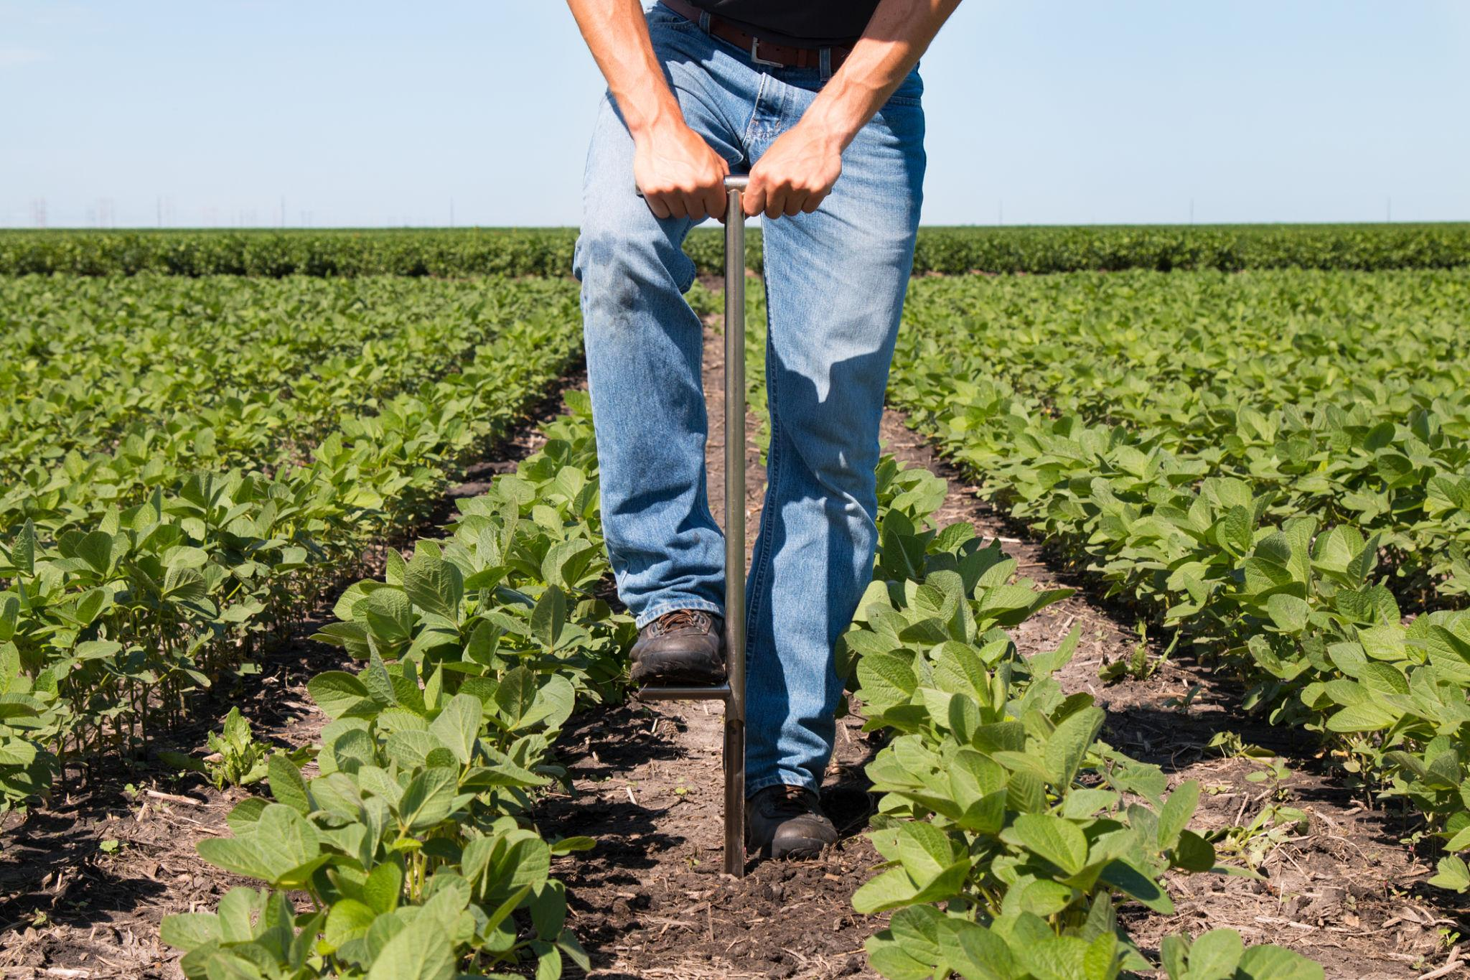
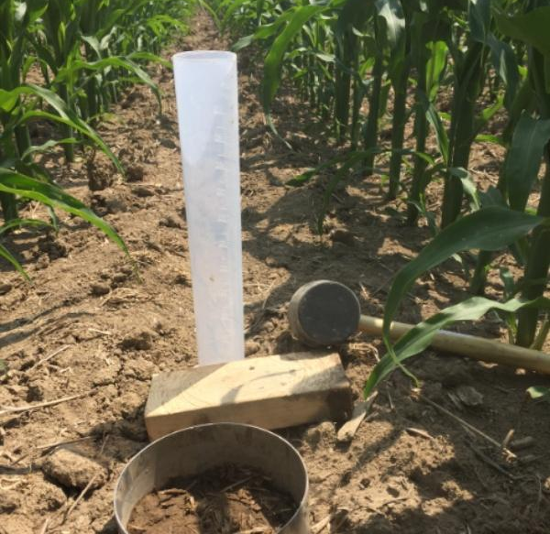
What Is a Compaction Assessment?
A simple field check to locate and confirm compacted soil.
1. Observe
Ponding • Wheel tracks • Poor crop growth
2. Dig
Examine the soil profile for dense layers & restricted roots
3. Test
Compare soil resistance with an unaffected area
4. Record
Note depth, moisture & location

Slide 27
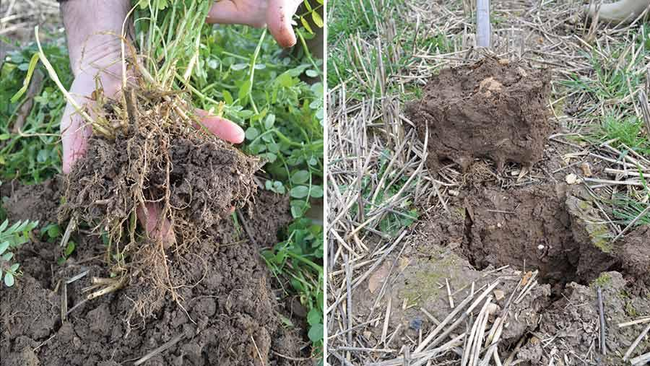
Techniques to Fix Compaction
1. Diagnose First
Identify depth & severity
Don’t automatically rip the whole field
2. Address the Layer
Surface: Light treatment + protect with residue/cover
Subsurface: Rip or chisel when soil is dry
Never rip wet soil
3. Prevent It From Returning
Reduce traffic & unnecessary passes
Vary tillage depth
Keep soil covered
Build organic matter with compost, residues & cover crops
Diagnose → Correct → Prevent

Slide 28
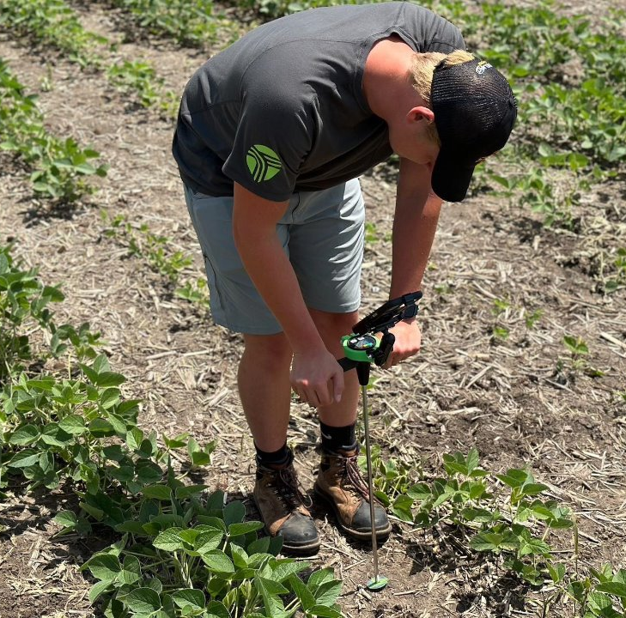
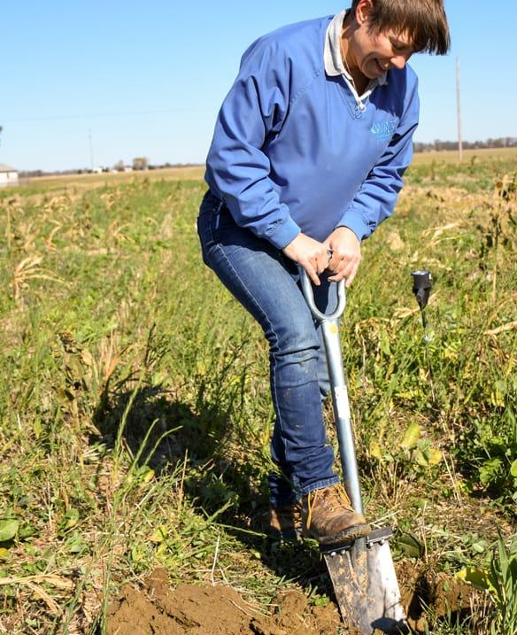
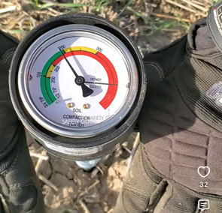
Diagnose Compaction With Equipment
Have a Penetrometer?
Measure resistance by depth
Take multiple readings
Compare with an unaffected area
Simple Field Checks
Dig: Look for dense layers & restricted roots
Push: Compare resistance with a rod or probe
Infiltrate: Check how quickly water enters the soil

Slide 29
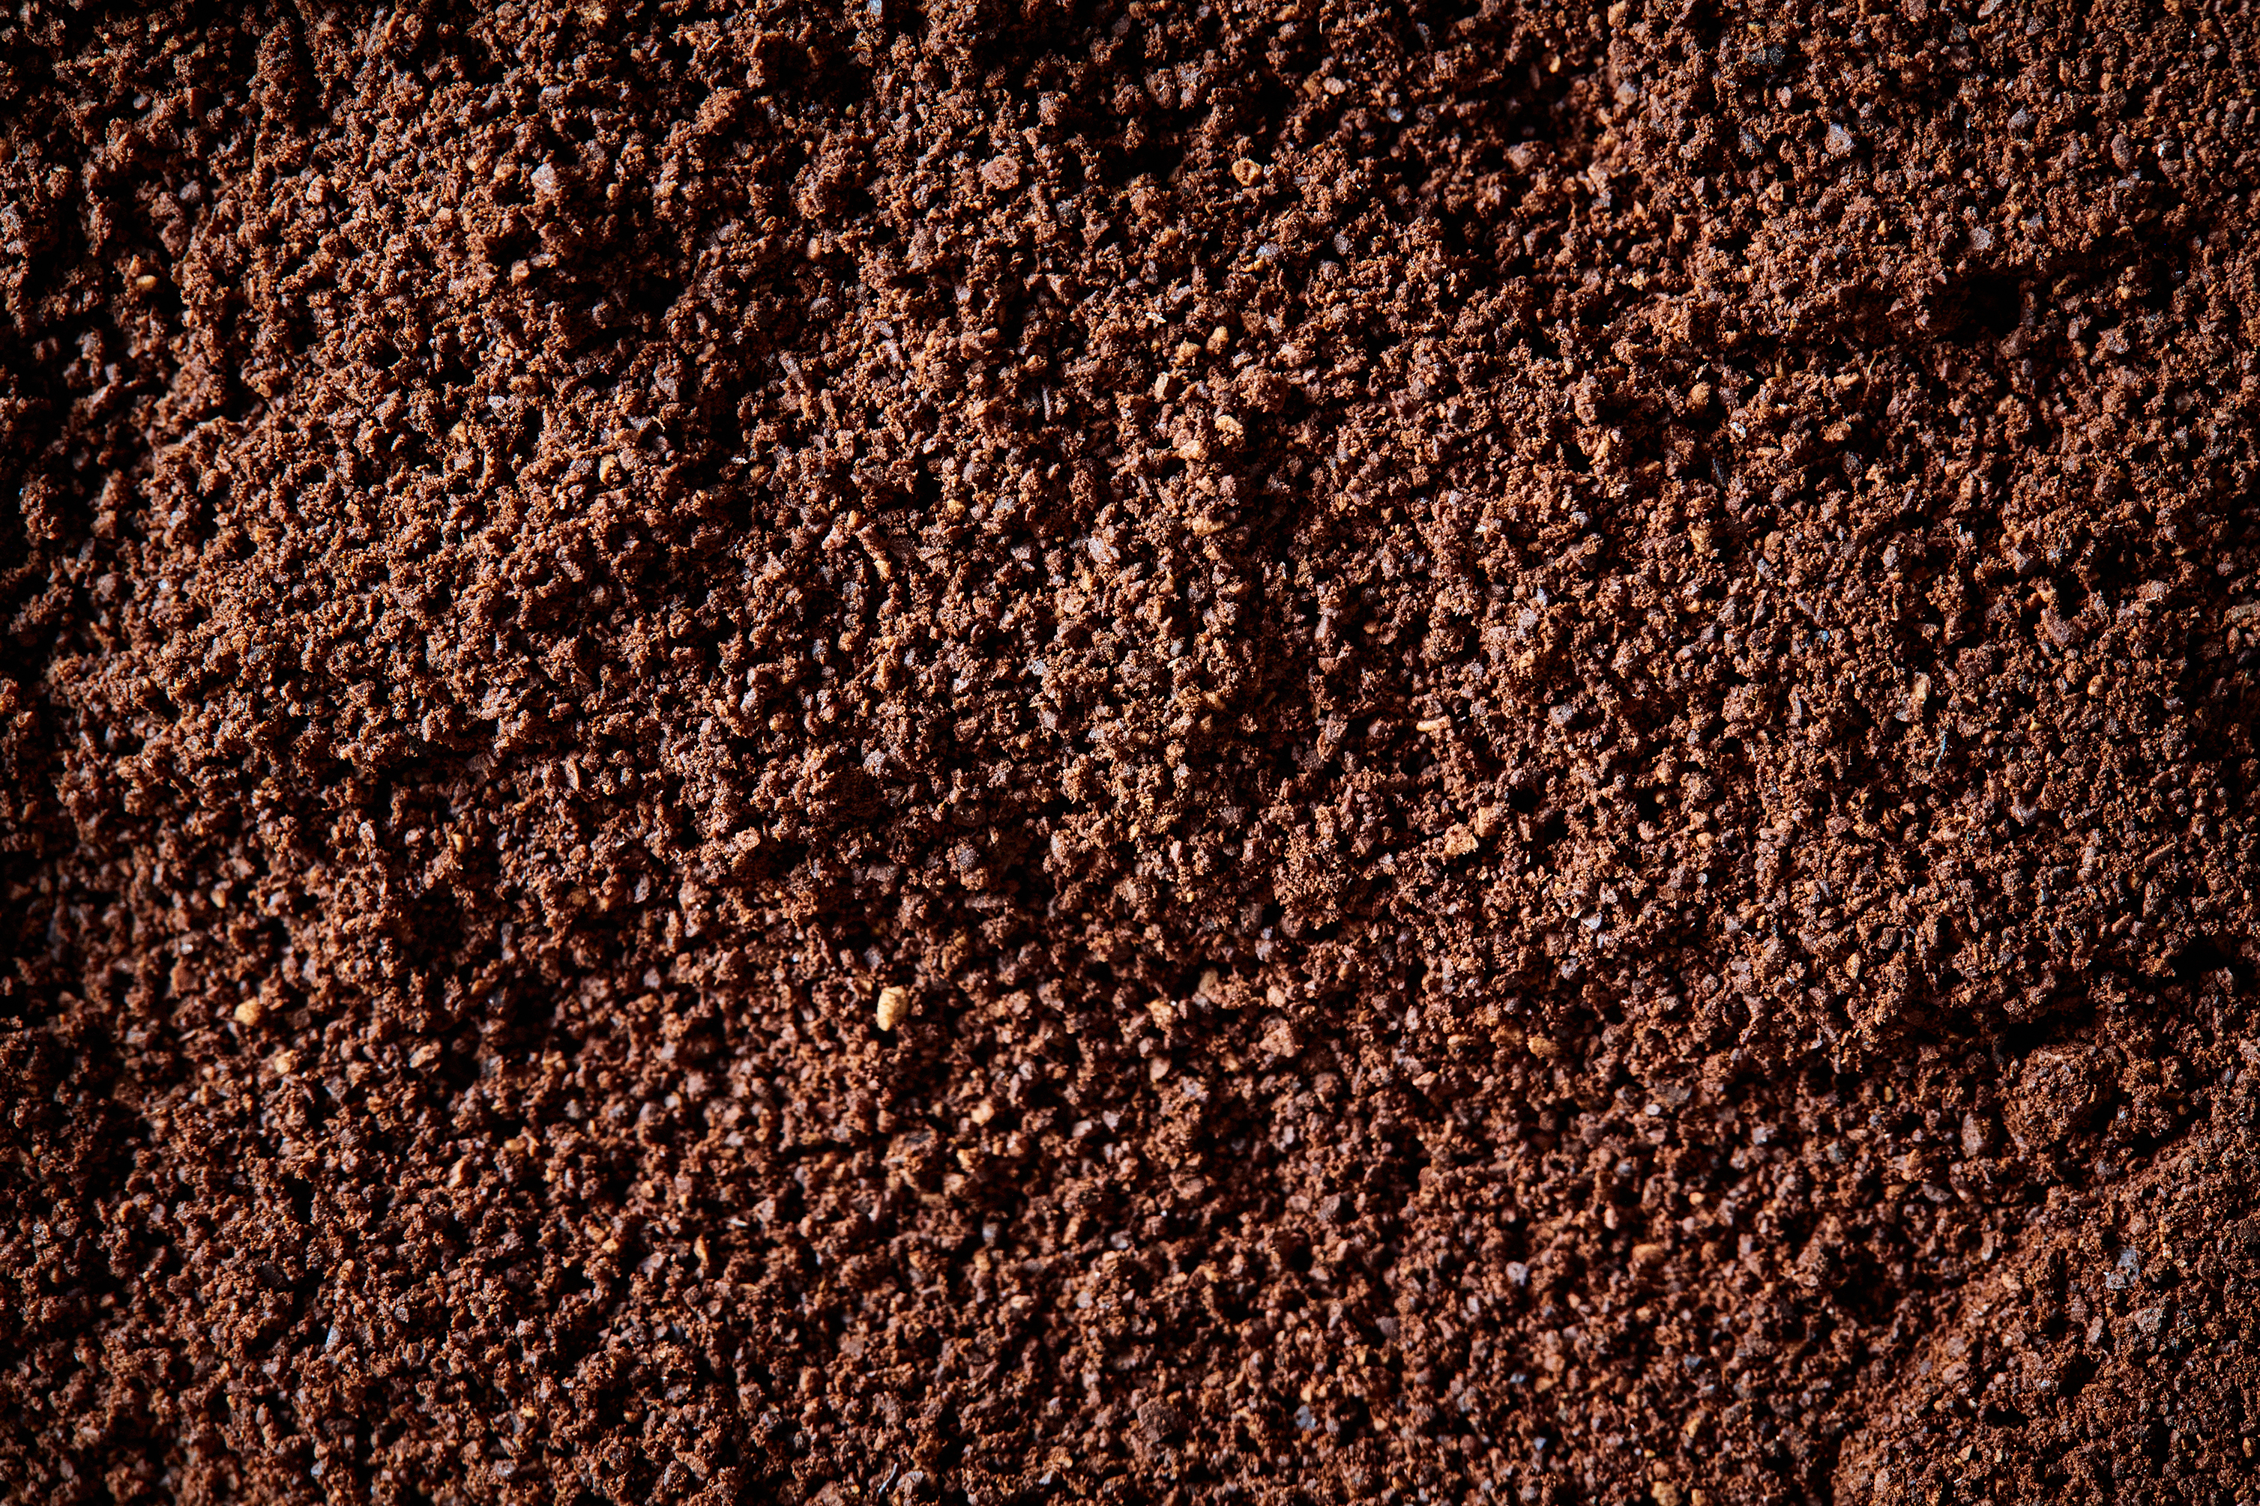
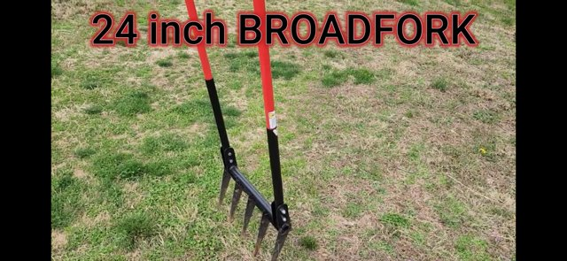
Solutions and Prevention
Avoid field traffic and tillage when soil is wet
Designate permanent traffic lanes/paths
Reduce unnecessary trips
Use appropriate tire pressure and distribute equipment weight
Keep soil covered with residue, mulch, or living cover crops
Build soil organic matter with compost and crop residues

Slide 30
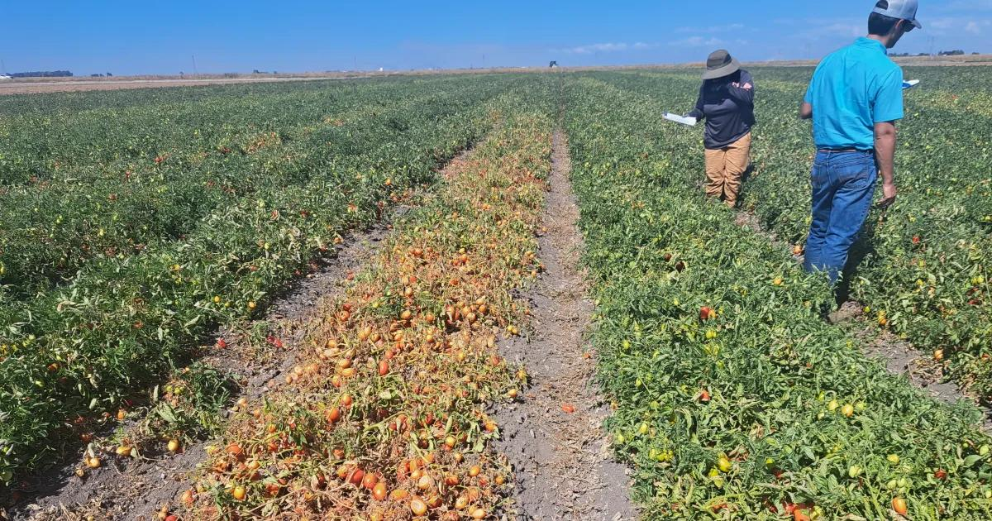
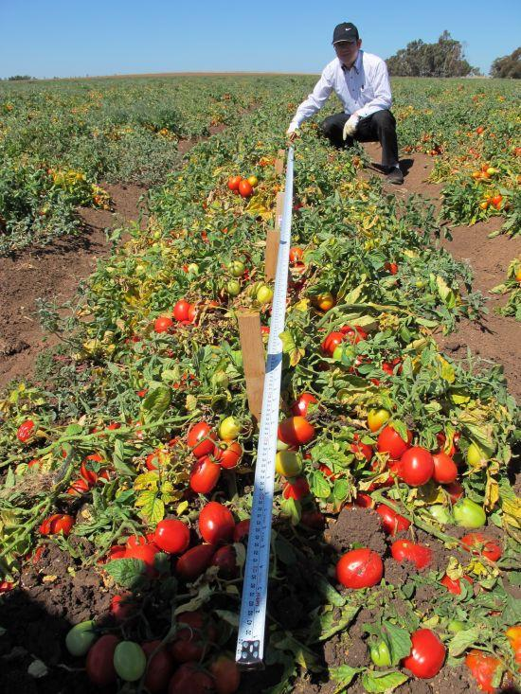
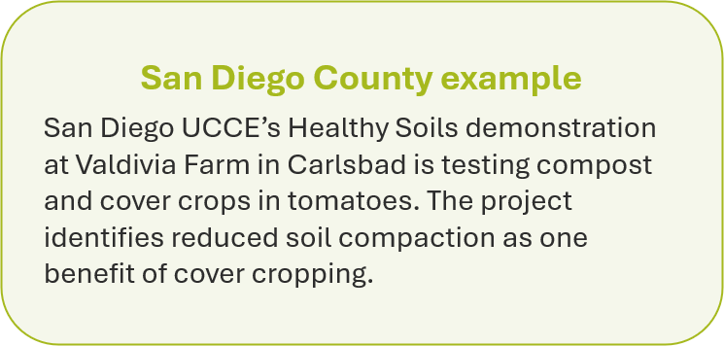

Slide 31
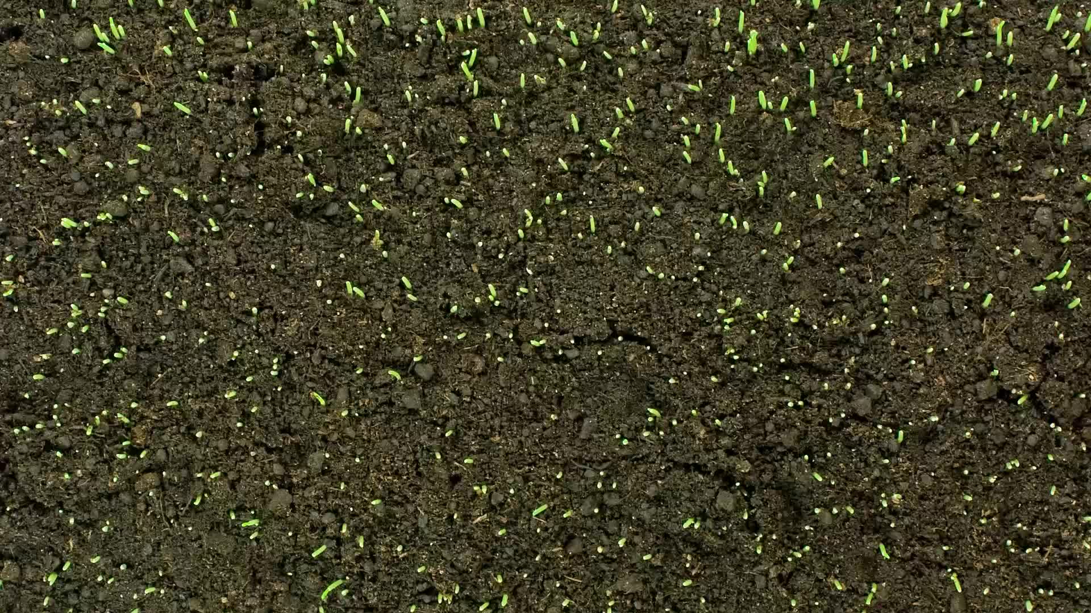
Soil Resources

Slide 32





UCANR Soil Resources
WETA Irrigation Evaluation Program
Scan for Links!

Slide 33

Web Soil Survey (WSS)

Slide 34
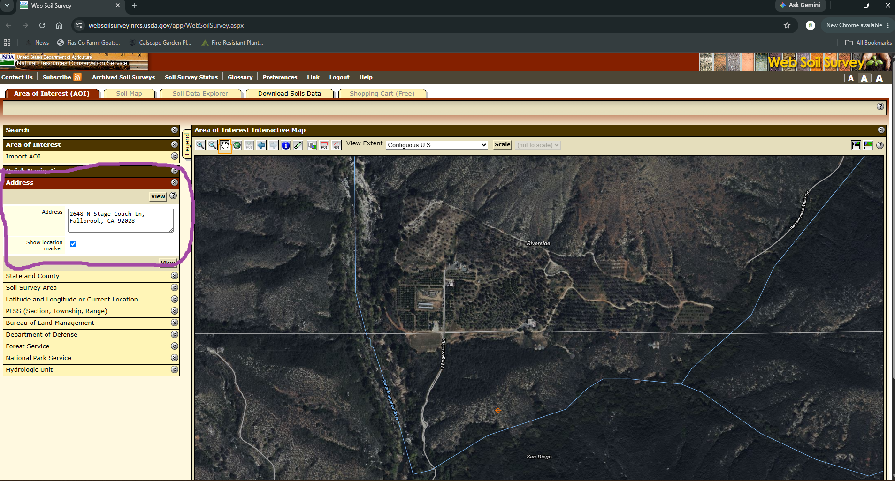

Slide 35
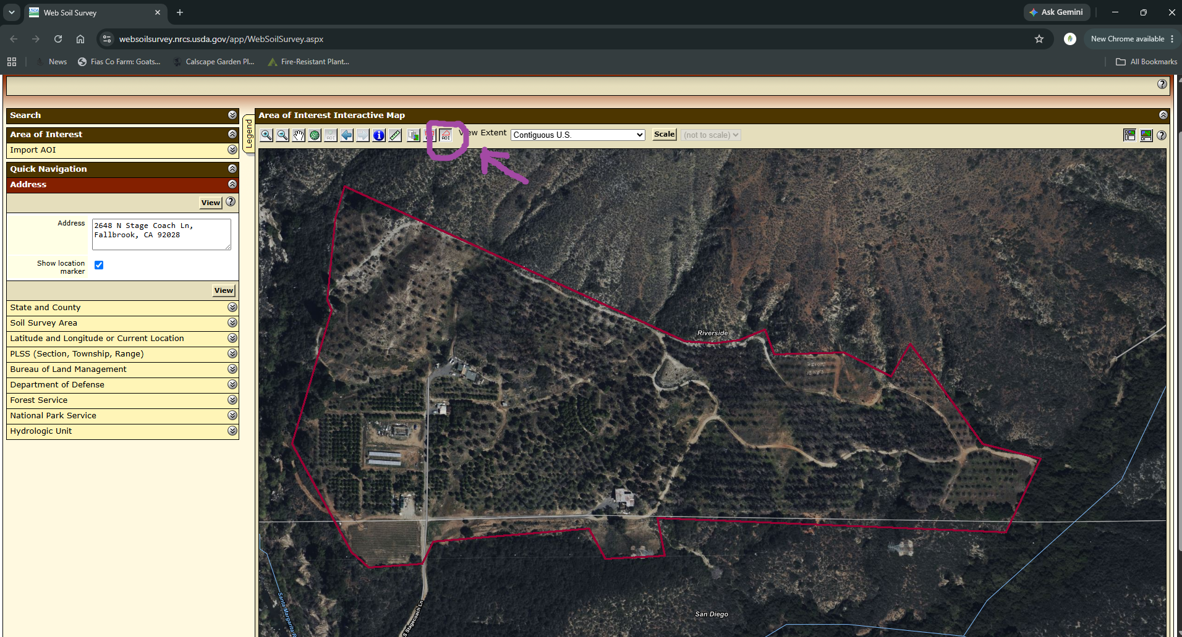

Slide 36
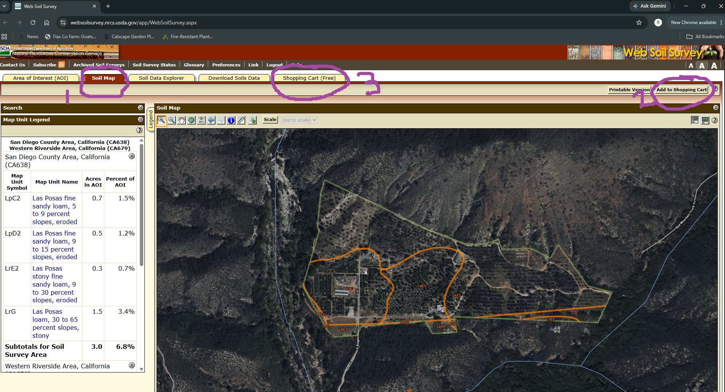

Slide 37
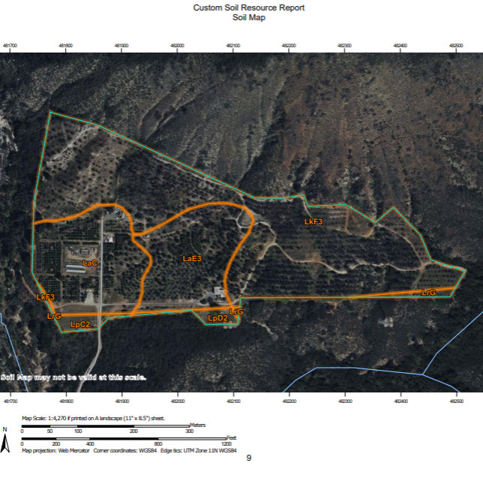
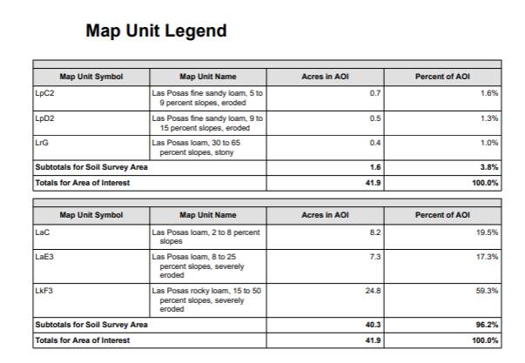

Slide 38
Works Cited
UC ANR. “Strategies to Avoid and Manage Soil Compaction.” Sacramento Valley Field Crops.
https://ucanr.edu/blog/sacramento-valley-field-crops/article/strategies-avoid-and-manage-soil-compaction
UC ANR. “Soil Compaction Alleviation.”
https://ucanr.edu/sites/default/files/2017-12/274957.pdf
UC ANR. “Identify Soil Problems.”
https://ucanr.edu/sites/default/files/2016-01/230297.pdf
UC ANR. “Got Compaction? How to Improve Soil Drainage.”
https://ucanr.edu/node/163768/printable/print
UC ANR. “Healthy soils for healthy alfalfa stands—What are the strategies?”
https://ucanr.edu/blog/alfalfa-forage-news/article/healthy-soils-healthy-alfalfa-stands-what-are-strategies
UC IPM. “Alfalfa: Irrigation and Wheel Traffic Considerations.”
https://ipm.ucanr.edu/PMG/C001/m001scirrwheel.html

Slide 39
Works Cited Cont.
UC ANR. “Soil Compaction by Tractors.” California Agriculture.
https://calag.ucanr.edu/download_pdf.cfm?article=ca.v006n09p7
UC ANR. “Overinflated Tractor Tires Waste Fuel, Reduce Productivity.”
https://my.ucanr.edu/repository/view.cfm?article=69753&groupid=1
UC ANR. “Soil Compaction Effects on Oxygen Diffusion Rates and Plant Growth.” California Agriculture.
https://calag.ucanr.edu/download_pdf.cfm?article=ca.v019n03p4

